Slide 1

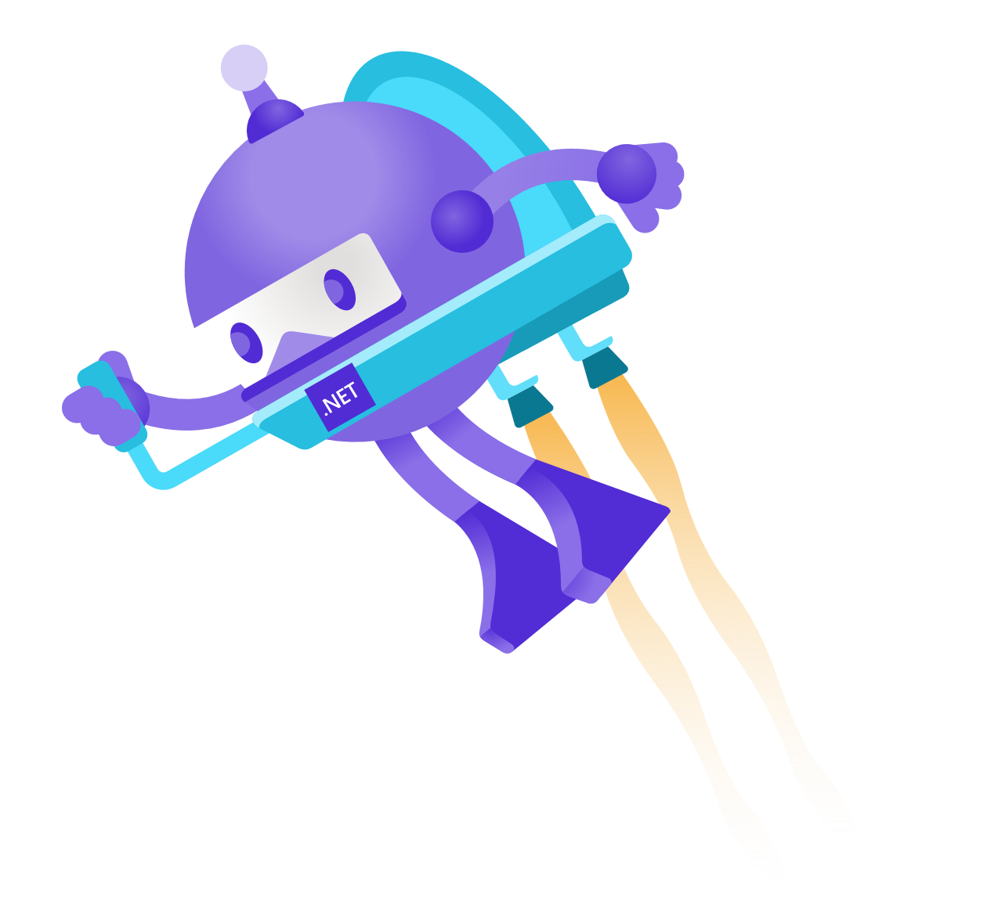

AI Enrichment with Azure Cognitive Search
Luis Beltrán

Slide 2







Luis Beltrán
Researcher
Lecturer
Passionate about Xamarin, Azure & AI
@darkicebeam
luis@luisbeltran.mx

Slide 3
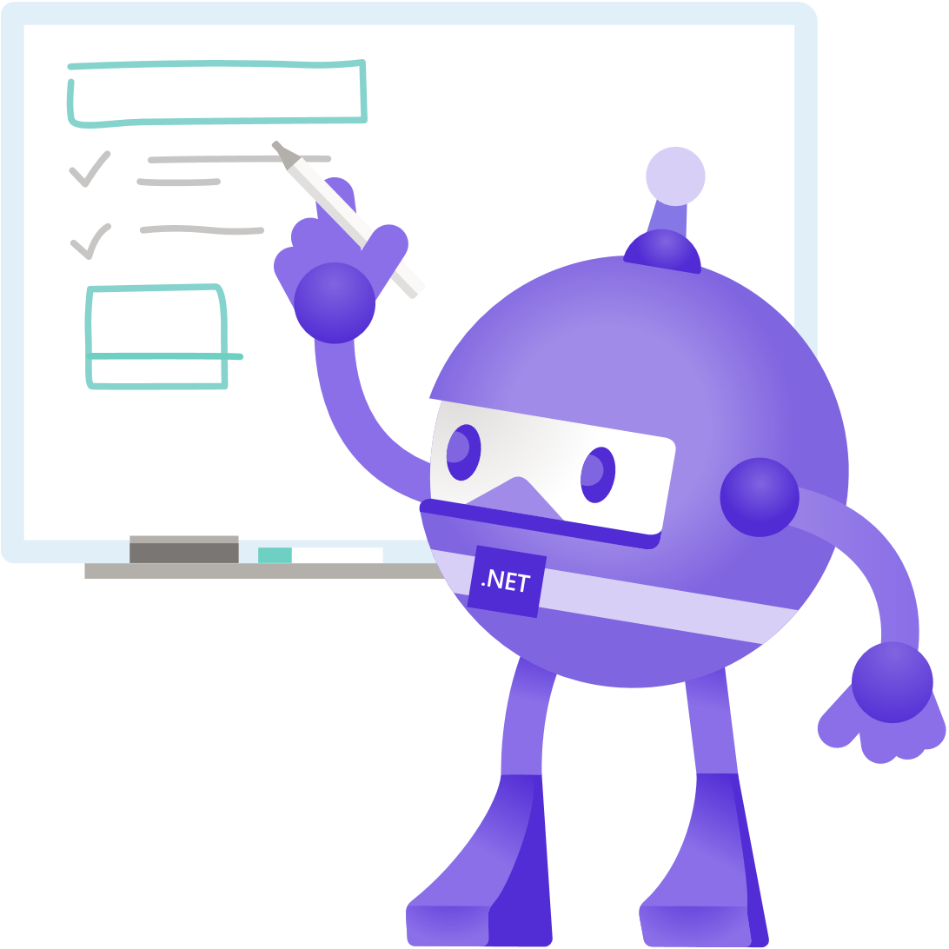
Agenda
What is Azure Cognitive Search?
AI Enrichment
Description
Steps
Demo
Resources

Slide 4
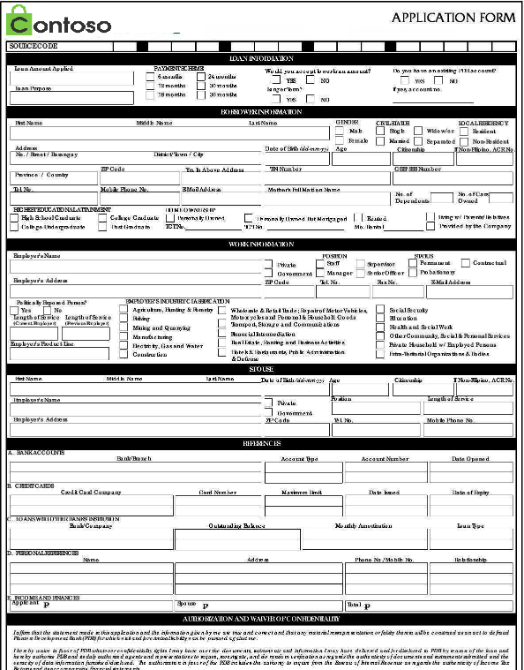
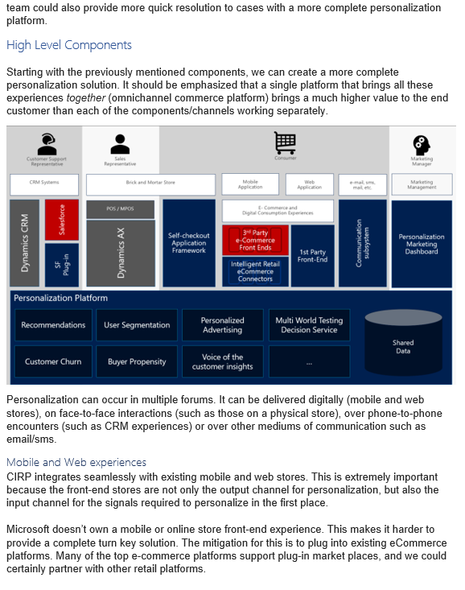
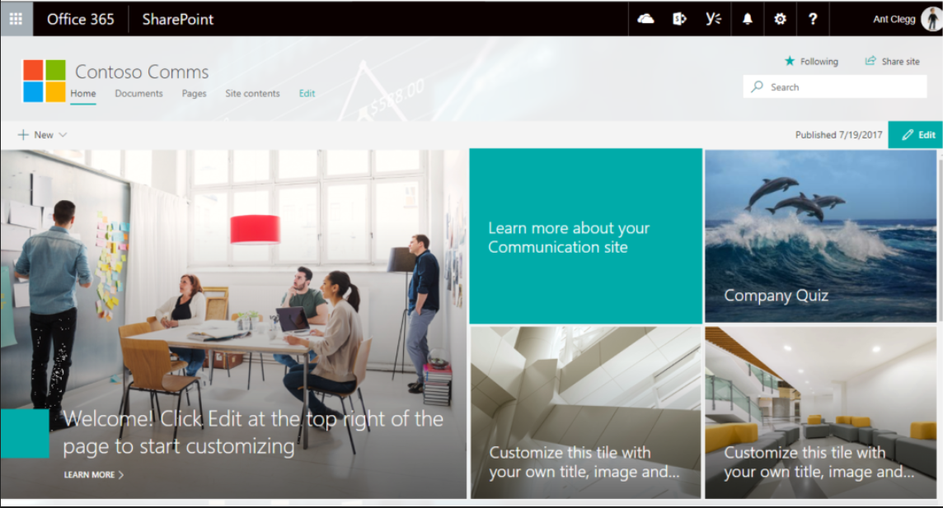

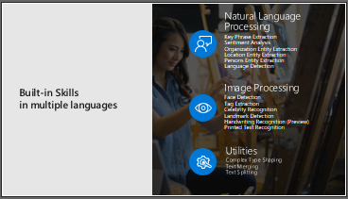




HTML
PNG

Slide 5
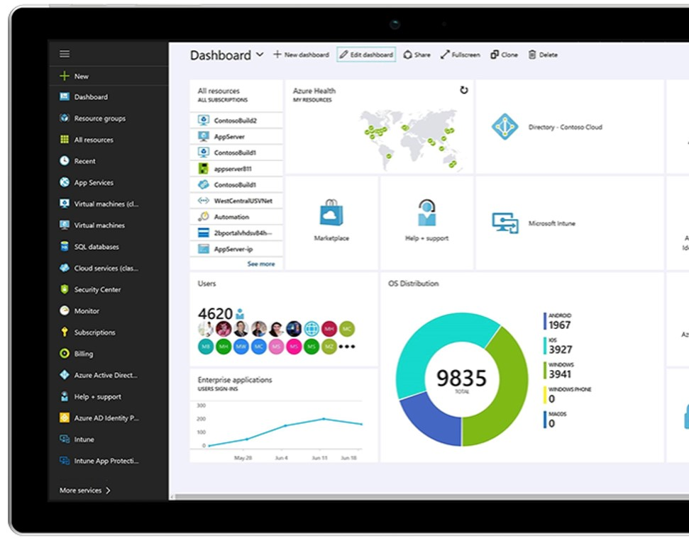
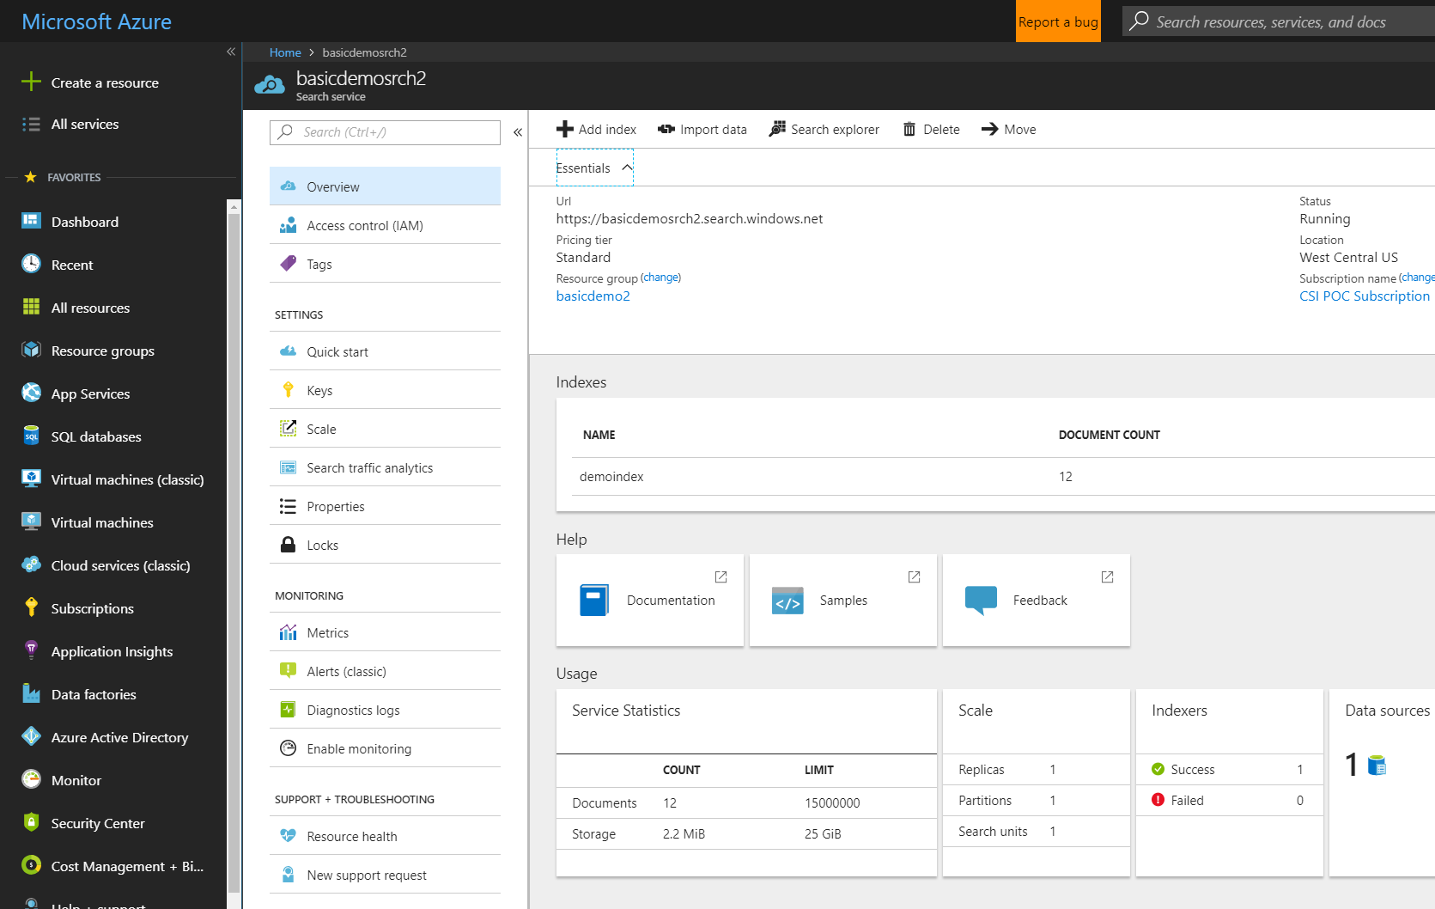
Azure Cognitive Search Search-as-a-service
management free
keyword search
faceting language analyzers
geospatial support
suggestions/auto-complete
customizable scoring
proximity search
synonyms, etc

Slide 6
AI Enrichment
AI Enrichment is a capability of Azure Cognitive Search indexing used to extract text from images, blobs, and other unstructured data sources.
Enrichment and extraction make your content more searchable in an index or knowledge store.
Extraction and enrichment are implemented using cognitive skills attached to the indexing pipeline.

Slide 7
At a high level…
Ingest
Enrich
Explore
Cognitive skills
Data in any
format, any
Azure store
Search
Annotations

Slide 8


Cognitive Search Architecture
IEnricher
IEnricher
Cognitive Skill
Document Cracking
Skillset:
Extensible enrichment
pipeline
Indexing for Search
Customer Data
Annotated Documents
Search Index
Ingest
Enrich
Explore

Slide 9
Steps in an enrichment pipeline
An enrichment pipeline is based on indexers.
Indexers populate an index based on field-to-field mappings between the index and your data source for document cracking.
Skills, now attached to indexers, intercept and enrich documents according to the skillset(s) you define.
Once indexed, you can access content via search requests through all query types supported by Azure Cognitive Search.

Slide 10
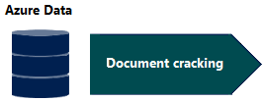
Step 1. Connection & document cracking phase
At the start of the pipeline, you have unstructured content (images, scanned documents, JPEG files).
Data must exist in an Azure data storage service that can be accessed by an indexer.
Indexers can "crack" source documents to extract text from source data. Document cracking is the process of extracting or creating text content from non-text sources at indexing.
Indexing takes time so start with a small, representative data set, then build it up incrementally as your solution matures.

Slide 11
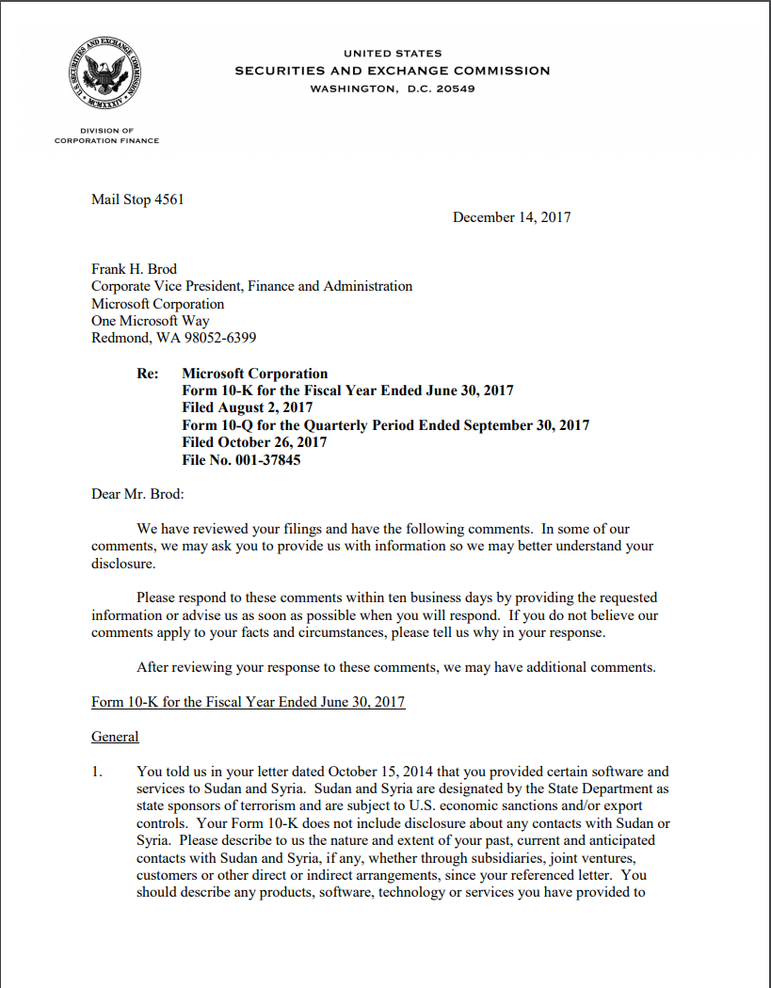
Document cracking
text
Different types of data sources
Blob Storage
Azure SQL
Cosmos DB
Azure Tables
MySQL
Azure Files
File formats supported in blob storage:
metadata
images
pdf
xml
png
doc
ppt
xls
rtf
json
html

Slide 12
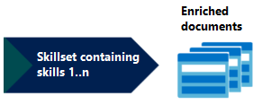
Step 2. Cognitive skills and enrichment phase
Enrichment is performed with cognitive skills doing atomic operations.
For example, once you have cracked a PDF, you can apply entity recognition, language detection, or key phrase extraction to produce new fields in your index that are not available natively in the source.
Altogether, the collection of skills used in your pipeline is called a skillset.

Slide 13




Cognitive Skills
Built-in skills
Custom skills
Key Phrase extraction
Location entity extraction
Sentiment analysis
Your custom skill goes here!
Organization entity extraction
Persons entity extraction
Language detection
Face detection
Celebrity recognition
Image tag extraction
Text Utilities
Landmark detection
Printed text recognition
Azure Databricks
Azure Machine Learning
Machine Learning VMs

Slide 14
Sample skillset
text
organization entity recognition
merge text
images
location entity recognition
OCR (text recognition)

Slide 15

Step 3. Search index and query-based access
When processing is finished, you have a search index consisting of enriched documents, fully text-searchable in Azure Cognitive Search.
Querying the index is how developers and users access the enriched content generated by the pipeline.
The index is like any other you might create for Azure Cognitive Search: you can supplement with custom analyzers, invoke fuzzy search queries, add filtered search, or experiment with scoring profiles to reshape the search results.

Slide 16
Indexes are generated from an index schema that defines the fields, attributes, and other constructs attached to a specific index, such as scoring profiles and synonym maps.
Once an index is defined and populated, you can index incrementally to pick up new and updated source documents.
Certain modifications require a full rebuild. You should use a small data set until the schema design is stable.

Slide 17
Demo
Luis Beltrán

Slide 18
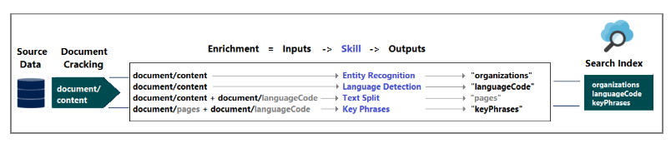
In this demo, services and data are combined in the Azure cloud to create the skillset.
The end result is a searchable index populated with data created by AI processing that you can query in your apps.
This demo uses Azure Cognitive Search, Azure Blob storage, and Azure Cognitive Services for the AI.

Slide 19
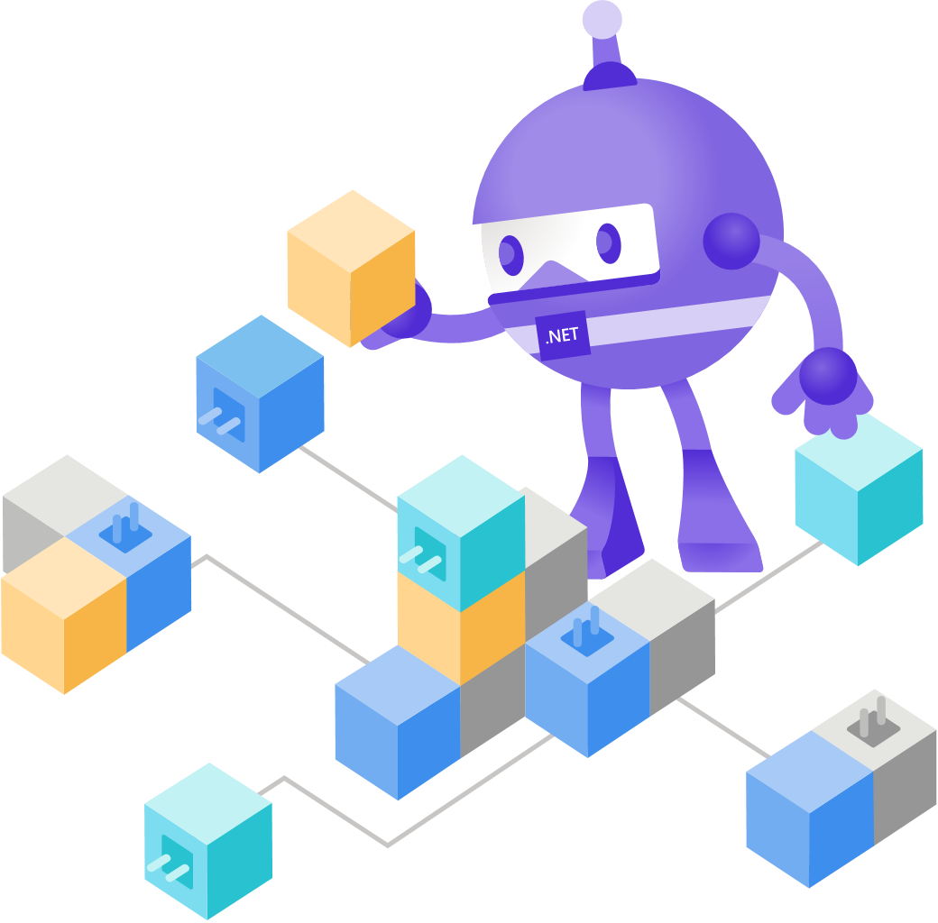
Call to Action
Introduction to AI enrichment
https://docs.microsoft.com/en-us/azure/search/cognitive-search-concept-intro
Quickstart: Create an Azure Cognitive Search cognitive skillset in the Azure portal
https://docs.microsoft.com/en-us/azure/search/cognitive-search-quickstart-blob

Slide 20
Call to Action
Tutorial: Use REST and AI to generate searchable content from Azure blobs
https://docs.microsoft.com/en-us/azure/search/cognitive-search-tutorial-blob
Tutorial: Use C# and AI to generate searchable content from Azure blobs
https://docs.microsoft.com/en-us/azure/search/cognitive-search-tutorial-blob-dotnet

Slide 21

Q & A

Slide 22
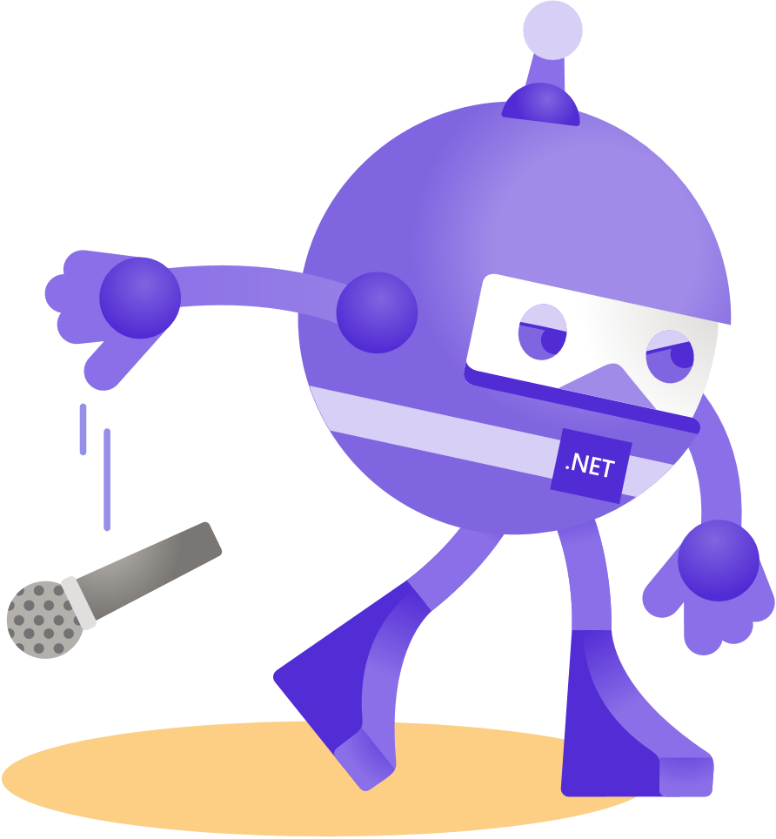
Thanks for joining!
Luis Beltrán
@darkicebeam

